Slide 1
Team #7 Kimchi Up
Red Light Running
Jideok Park, Hyein Seo, Sujeong Lee,
Kevin Saligoe, Quingyuan Hu

Slide 2
Table of Contents
PART 1 Project
Description
PART 2 Project Detail
PART 3 Experiments
PART 4 Conclusion

Slide 3
01
Project Description

Slide 4


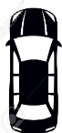
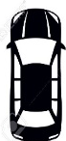
01Project description
Red Light Running
?
A behavior that drivers run through the red light even though the regulations
indicate that driers must stop their vehicles as soon as the traffic light turns red
Stop Line
Stop Line
Case 1
Case 2

Slide 5
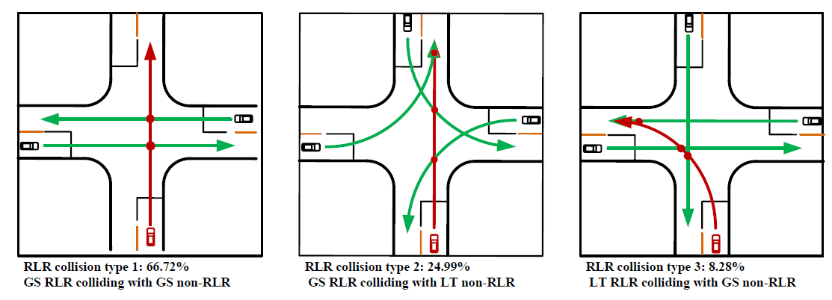
Problem study
We found that go-straight RLR vehicle is the most collision type in signalized intersection.
So we focus on go-straight RLR vehicle.

Slide 6
PART 01
02
Project Detail

Slide 7


02Concept of the project
The red light by laser pointer will show the line
Depending on the speed of car(SSD)
car
$$②$$
When car is fast
Sensor,
Laser pointer
car
$$②$$
When car is slow
but red light running
Sensor,
Laser pointer

Slide 8
02Concept of the project
Lidar sensor
radar sensor
: Blind spot

Slide 9
02Concept of the project
Lidar sensor
radar sensor
: Blind spot

Slide 10

02Project Detail
System Diagram
Bluetooth
LED
Servo motor
Lidar
Radar

Slide 11
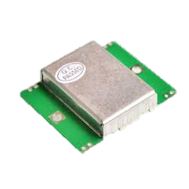
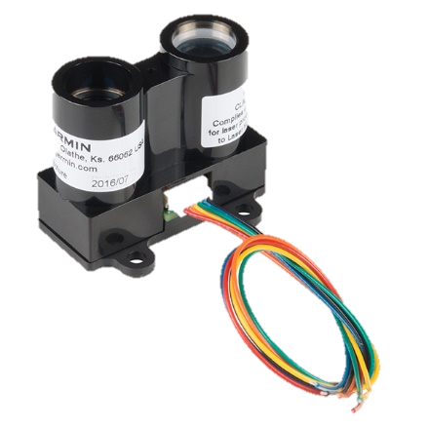
02Project Detail
Sensors used in study
LIDAR Lite v3
HB 100 Radar Module
Range : 40 m (131 ft)
Range : 1~25 m
Wide : 78°
Accuracy < 5m : ±2.5 cm (1 in.)
Accuracy ≥ 5m : ±10 cm (3.9 in.)

Slide 12
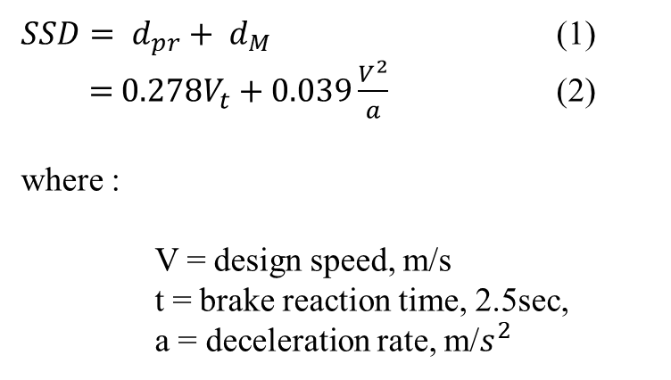
02Project Detail
Stopping Sight Distance (SSD)
$SSD= d_{pr}+ d_{M}$ (1)
$=$ $0.278V_{t}+0.039\frac{V^{2}}{a}$ (2)
where :
V = design speed, m/s
t = brake reaction time, 2.5sec,
a = deceleration rate, m/$s^{2}$
car
Stopping distance
Reaction distance
Braking distance
Hazard
detected
Braking
begins
The car
stands still

Slide 13







02Project Detail
Stopping Sight Distance (SSD)
Laser pointer
Laser pointer
$$θ$$
$$H_{1}$$
$$θ$$
$$H_{1}$$
RLR car
RLR car
$$D_{1}$$
$$D_{1}$$
$$θ=\tan^{−1}{⁡\frac{|D_{1}−SSD|}{H_{1}}}$$

Slide 14
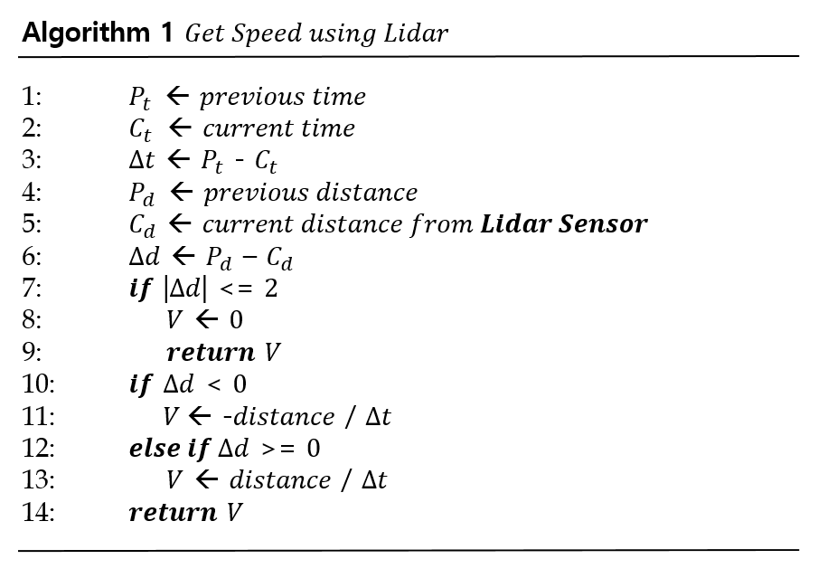
02Project Detail
Algorithm
Notes:
This algorithm is to get speed using lidar.
Whenever the distance value is measured by the Lidar sensor, the speed is calculated by the distance and the time.

Slide 15
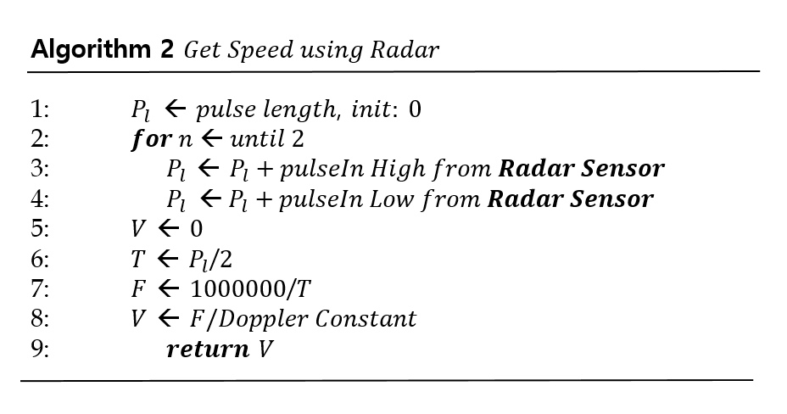
02Project Detail
Algorithm
Notes:
Algorithm2 describes the procedure of getting speed using radar.
By adding the value of pulse from 2 to Pl,
Speed is measured by frequency divided by Doppler constant

Slide 16
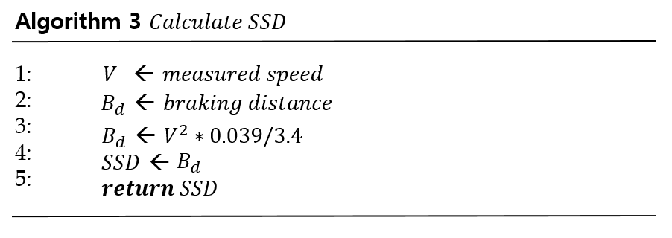
02Project Detail
Algorithm
Notes:
Algorithm 3 is the procedure of calculating Stopping Sight Distance.
It is the process of substituting measured value for the aforementioned SSD formula

Slide 17
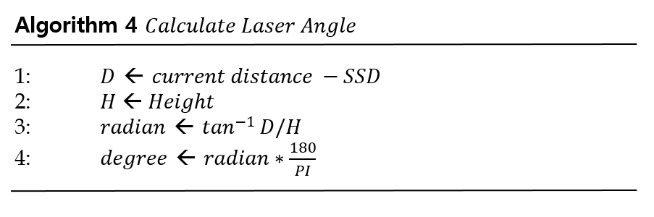
02Project Detail
Algorithm
Notes:
Algorithm 4 describes the procedure of calculating angle for turning laser sensor.
For this process, we can get a degree to move laser sensor.

Slide 18
PART 01
03
Experiments

Slide 19
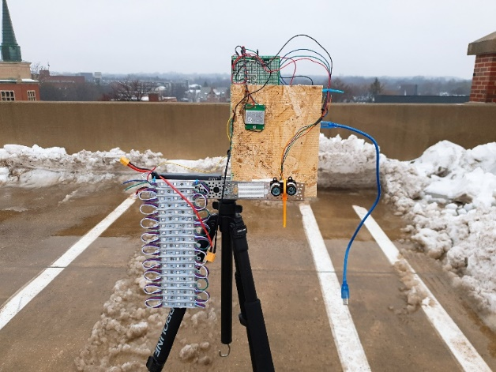
03Experiments
10 mph
Braking distance

Slide 20
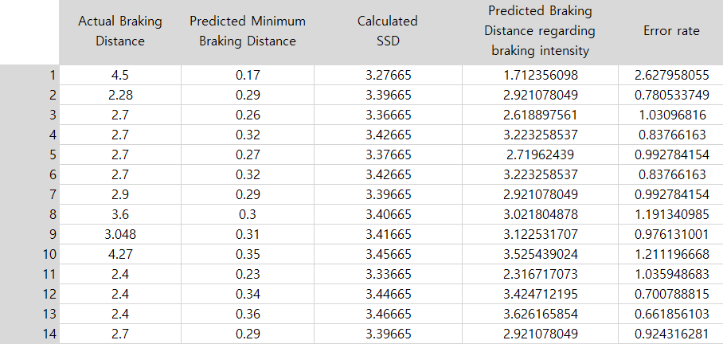
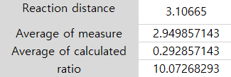
03Experiments
Stopping distance
Reaction distance
Braking distance
Hazard
detected
Braking
begins
The car
stands still

Slide 21
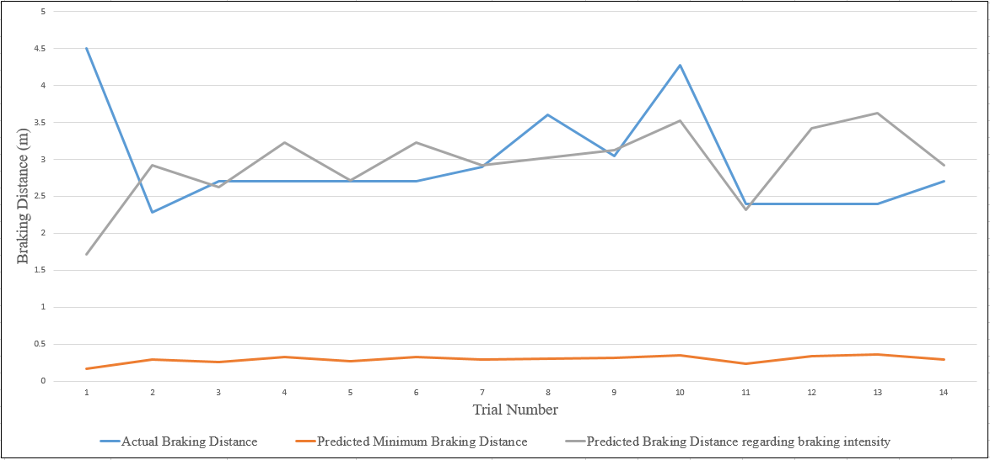
03Experiments
1. Braking Distance Graph

Slide 22
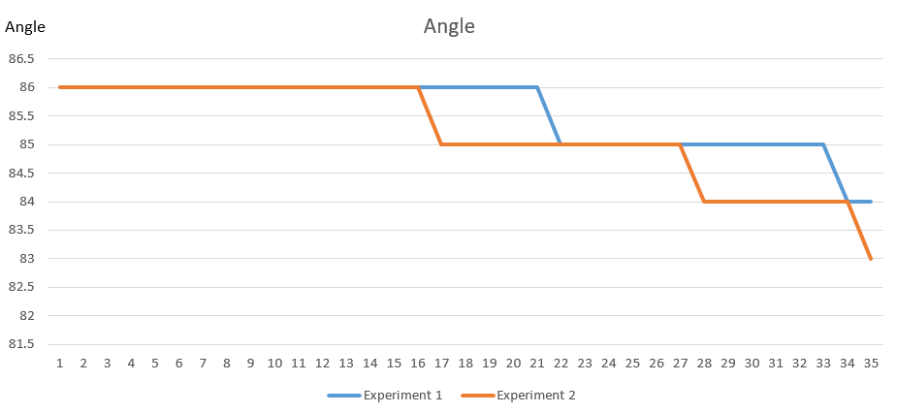
03Experiments
2. Get an angle for laser beam

Slide 23
04
Conclusion

Slide 24
04 Conclusion
Stopping sight distance = reaction distance + braking distance
Actual distance
Calculated distance

Slide 25

04 Conclusion
Future study needed…
More data sets to get a stopping distance
sensors that longer range and reliable values

Slide 26
Thank you
Q&A

